Slide 1

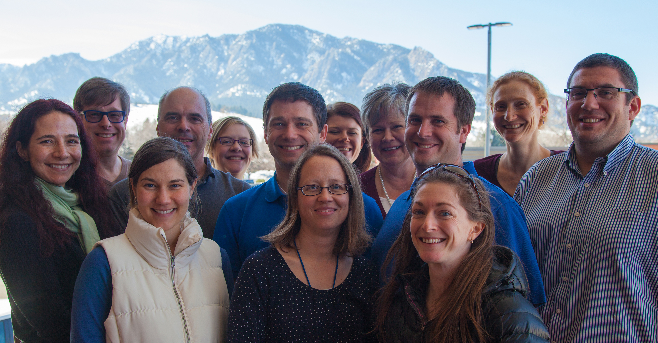

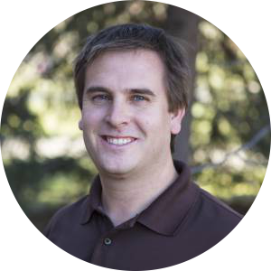
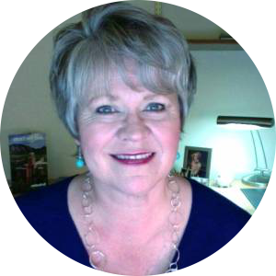
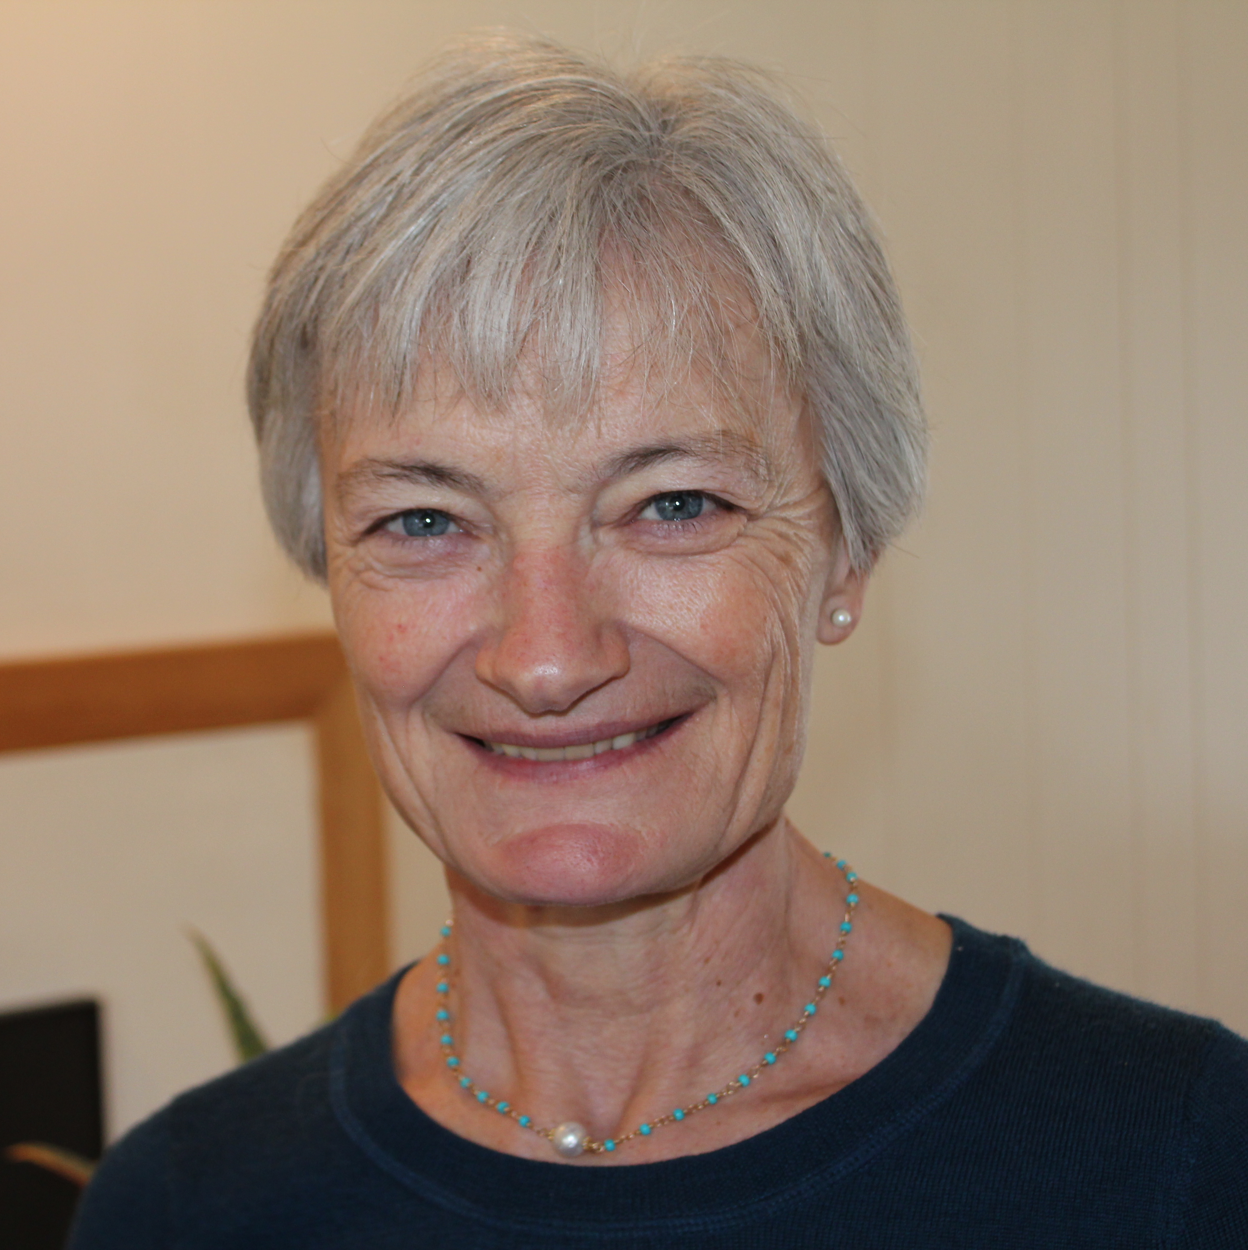
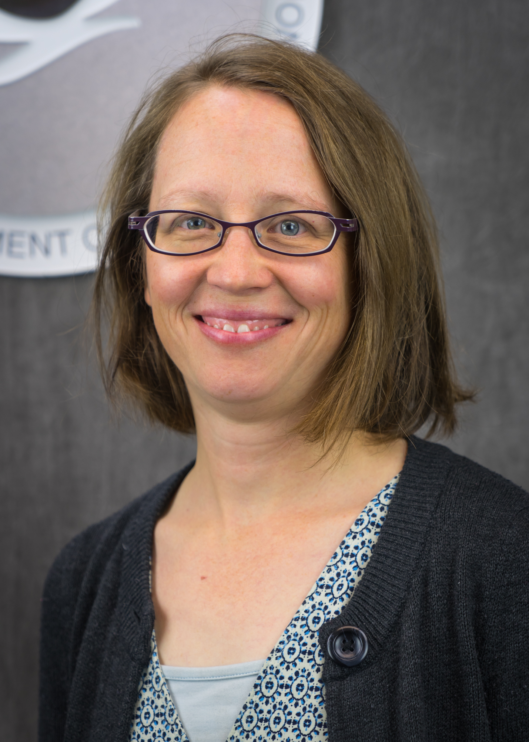
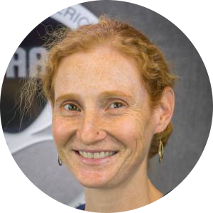
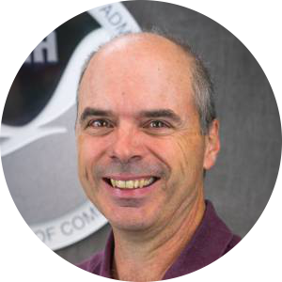
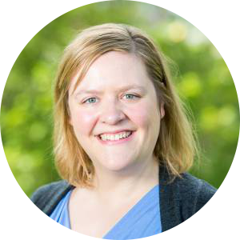
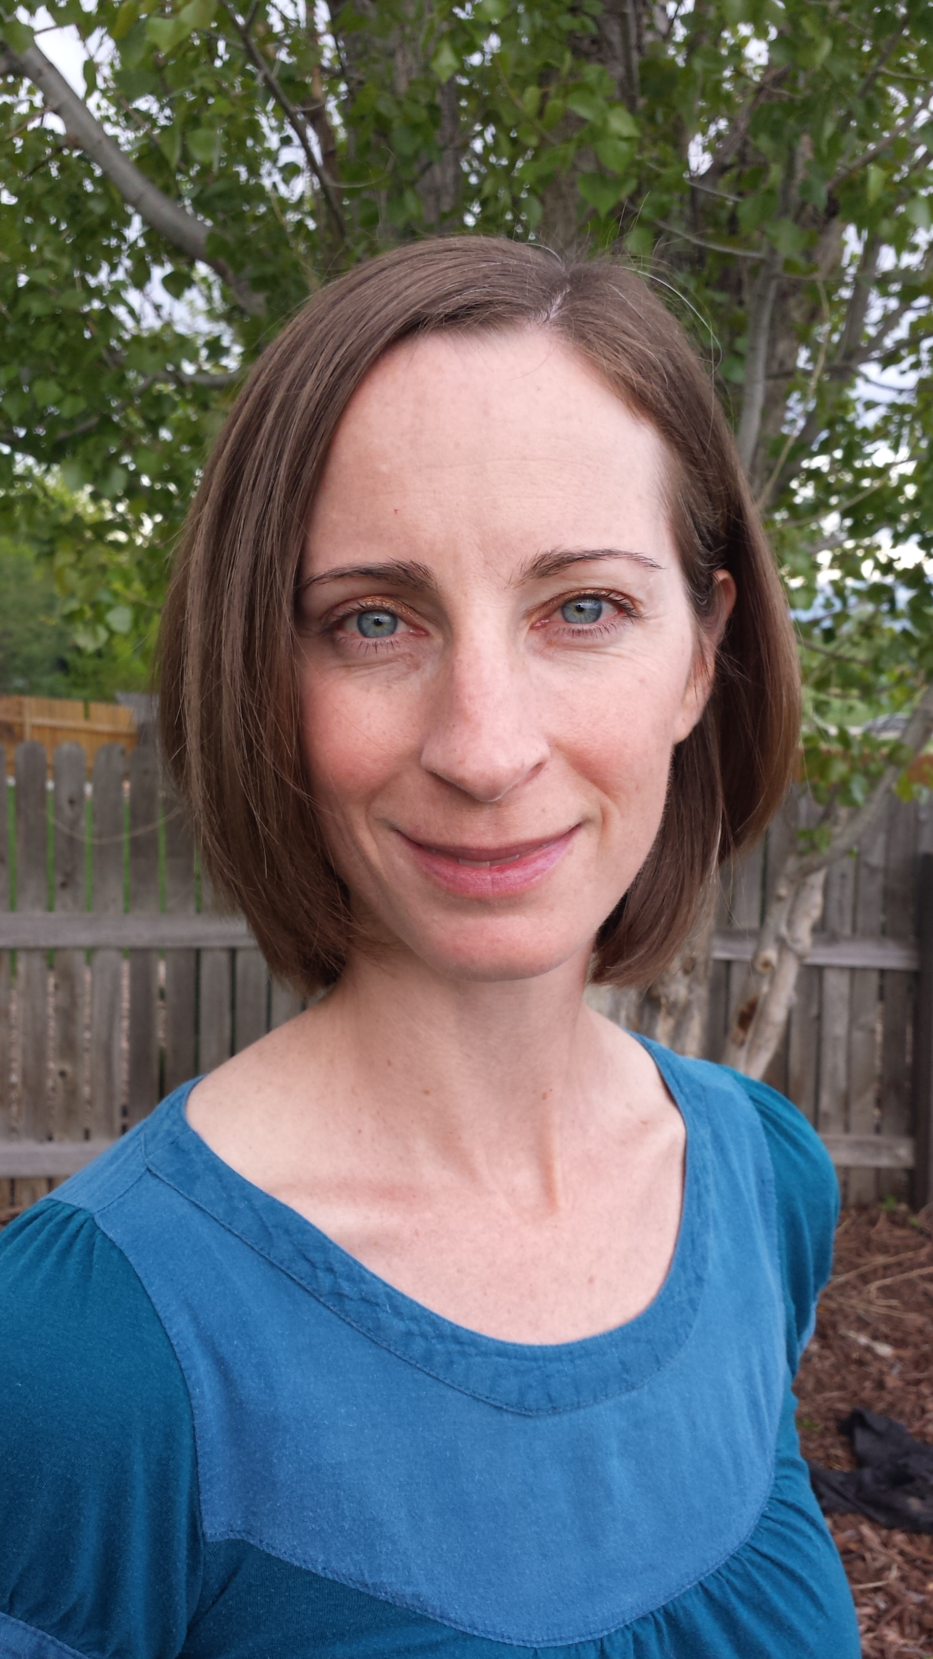
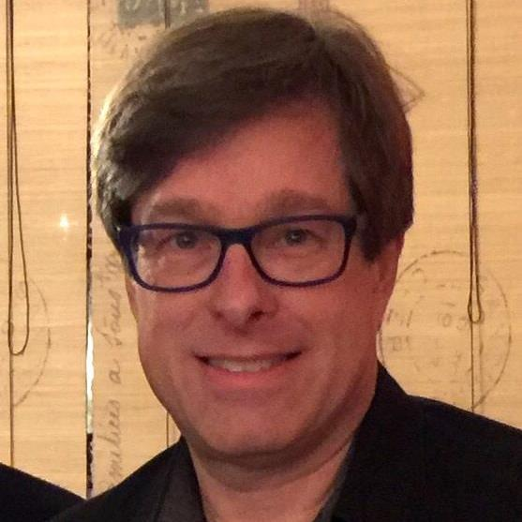
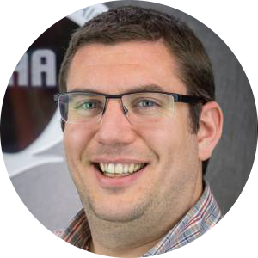
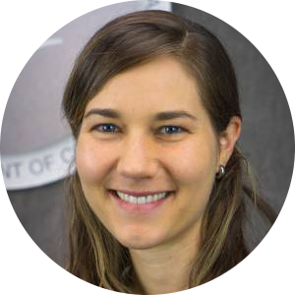
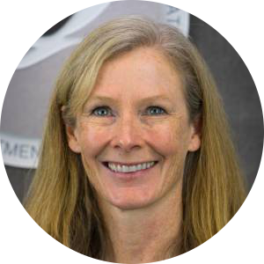
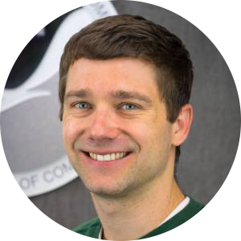
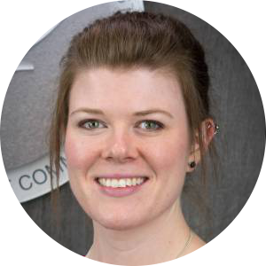
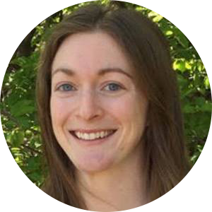
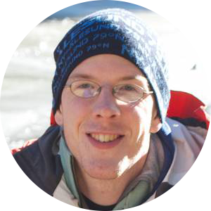
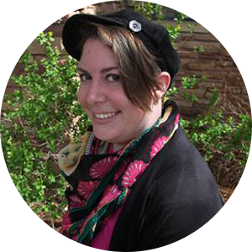
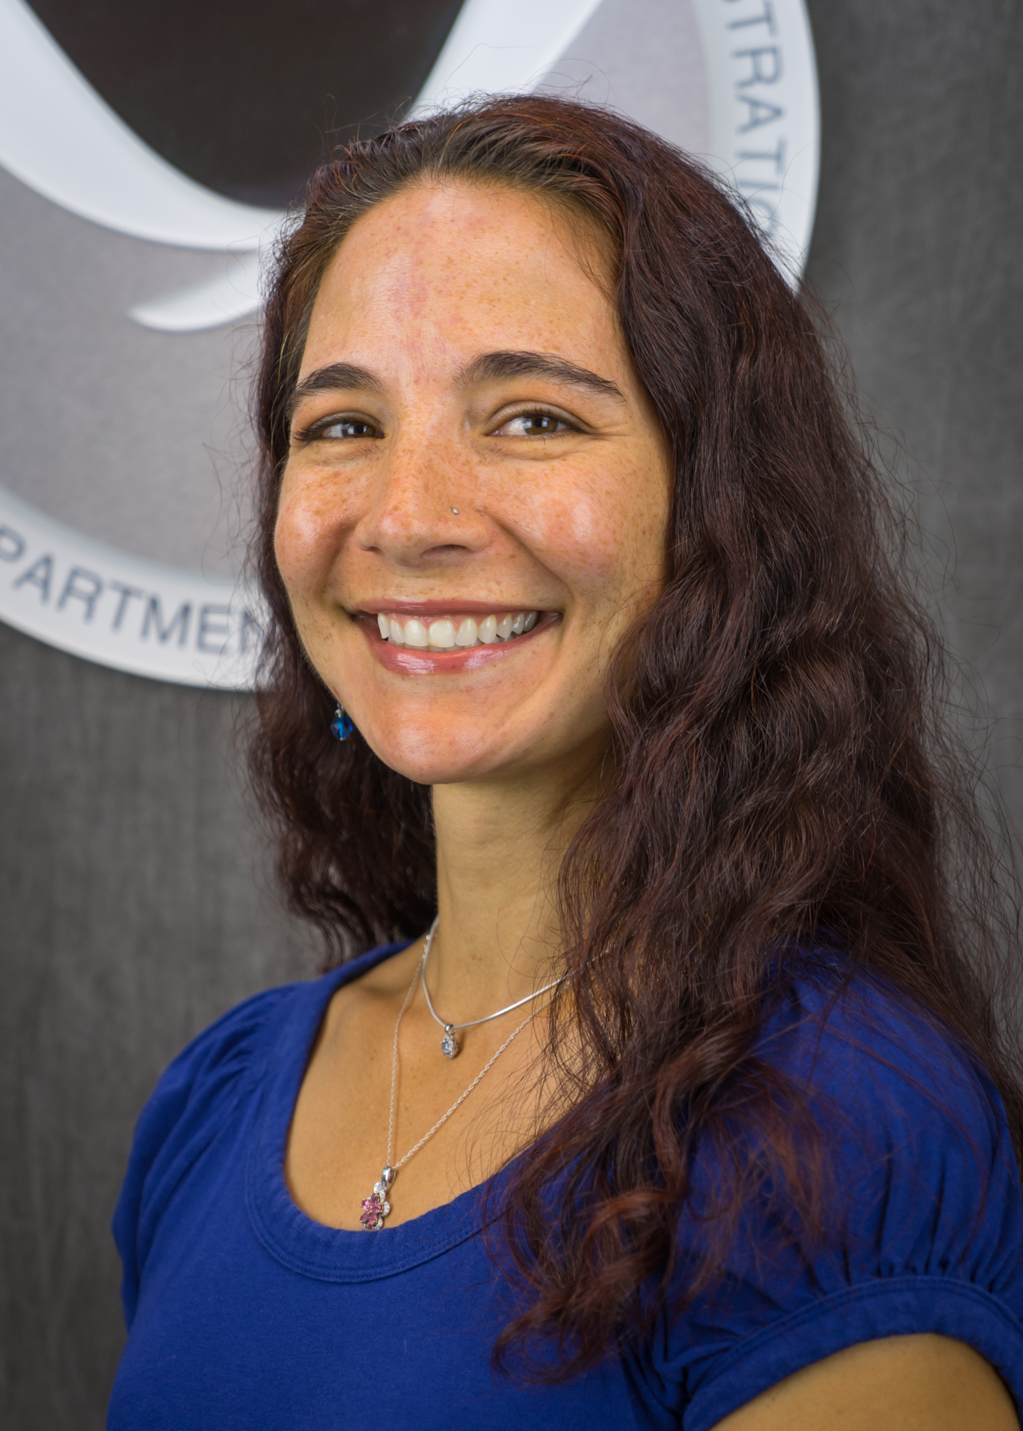

The CIRES Members’ Council
We’re here to help you!
Who we are:
Who we are:
CMC is a representative group tasked with:
Representing the concerns of the CIRES membership by bringing issues to the attention of the CIRES administration.
Working to improve the lines of communication within and among all CIRES units.
Providing a means of member participation in CIRES governance and a voice on committees and working groups, which form the core of that governance.
Contributing to the process which determines CIRES’ research direction and scientific themes.
Fostering a positive workplace environment and Members’ connections with CIRES by facilitating Members’ understanding of their roles within CIRES.
The CIRES Members’ Council provides the opportunity for service as well as career enhancement, benefiting representatives and constituents alike.
The CIRES Rendezvous is hosted by the CMC. We are heavily involved in the planning process with tremendous help from CIRES Administration, especially Linda Pendergrass!
Rendezvous is the highlight of annual events for CIRES in that it allows all of us to be together and to enjoy our collective and individual achievements. We hope that you will take this opportunity to network and enjoy the CIRES research!
CMC Rendezvous Committee:
Amanda Morton, Chair
Nathan Campbell
Christina Holt
Allen Pope
Amy Steiker
Robin Strelow
Richard Tisinai
Find your representative:
CIRES Outstanding Performance Awards
Main Campus
Awards are targeted at projects that are novel, high impact, and show remarkable creativity or resourcefulness.
Science and Engineering category
May involve any work that is related to the scientific process (forming and testing hypotheses to further our understanding of the environmental sciences), such as:
Development of new scientific, engineering and/or software tools or models directly resulting in novel research valuable to CIRES and the wider scientific community.
Uncommon initiative, resourcefulness, and/or scientific creativity conducting research with potential to expand or change the direction of a particular field or discipline.
Participation in collaborative and/or multidisciplinary research that engages a broader cross-section than the nominee’s typical scientific or engineering community.
Service category
May involve any work that facilitates, supports, enhances, or promotes work in the environmental sciences, such as:
Implementation of a creative or innovative idea, device, process, or system that aids in research, teaching, or outreach at CIRES.
Development or improvement of a service that increases the efficiency, quality or visibility of scientific research or outreach.
Providing a service that promotes or inspires excellence and dedication to research performed at CIRES or in the wider community.
Nate Campbell
Robin Strelow
GSD
PSD
NCEI
CSD
Antonietta Capotondi
Carrie Morrill
Anne Perring
Vice Chair
Craig Hartsough
Mimi Hughes
Carrie Bell
Rick Tisinai
Secretary
Chris Clack
SWPC
GMD
Want to get involved?
Michele Cash
Kathy Lantz
Chance Sterling
Membership Chair
Christina Holt
Chair
Share your thoughts and concerns with your Members’ Council representatives
Attend monthly Members’ Council meetings
Consider serving as a representative on the Members’ Council
East Campus
Amy Steiker
Allen Pope
Amanda Morton
Rendezvous Chair
Lucia Harrop
CIRES Liaison at DSRC
Contact Us: Email: CMC@cires.colorado.edu
Web: cires.colorado.edu/cmc

